Slide 1
PORT SECURITY
220000736

Slide 2
What is a port?
3 Definitions
In networking, a port is a virtual point where network connections begin and end. Ports are software-based and controlled by the operating system of a computer. Each port is associated with a distinct process or service.
A port in computer hardware is a jack or socket into which peripheral hardware can be plugged.
In computer software, a port is when a piece of software has been translated or converted to run on different hardware or operating system than it was initially designed for.

Slide 3
What is Port Security?
Ports are classified into two types:
physical ports (physical docking points where users can connect other devices to their computers).
logical ports (well-programmed docking points through which data flows over the internet).
A logical port holds the key to security and its consequences.

Slide 4
Logical Connection range numbers
Each logical connection is given a unique number. It ranges from 0 to 65536 for UDP ports and from 0 to 65535 for TCP ports. These are the logical connection endpoints that determine whether to use TCP/IP or UDP (both are communication protocols).

Slide 5
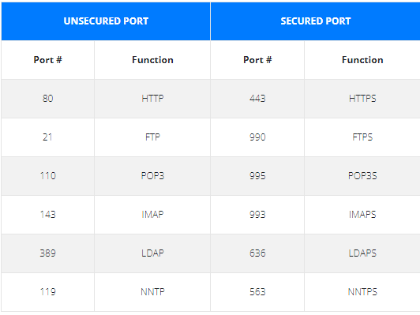
ssl
Secured Socket Layer also known as Secured Port, utilizes Secure Sockets Layer (SSL) certificates to protect internet connections. Here is a list of unsecured ports without SSL and secured ones with SSL certificate.

Slide 6
Securing a port in Packet tracer
Using port-security on the switch’s fa0/1 interface. First, the port will be converted to an access port, which will enable port security.
S1(config)#int fa0/1
S1(config-if)#switchport mode access
S1(config-if)#switchport port-security
Use the sticky command to dynamically learn the Mac address and provide the limit and appropriate action that should be taken.
S1(config-if)#switchport port-security mac-address sticky
S1(config-if)#switchport port-security
maximum 2
S1(config-if)#switchport port-security violation shutdown
If the user wishes to provide a static entry, begin it with its Mac address.
S1(config-if)#switchport port-security
S1(config-if)#switchport port-security violation shutdown
S1(config-if)#switchport port-security mac-address aa.bb.cc.dd.ee.ff

Slide 7
Conclusion
A web server, interacts with the clients via ports like 80, 443, … So to ensure web security, one must make an emphasis on port security. SSL and packet tracer commands are one of the technologies that can be used.

